Slide 1


Jure Pavlin
28/08/2023

Slide 2

Outline
Executive Summary
Introduction
Methodology
Results
Conclusion
Appendix

Slide 3
Executive Summary
For the purpose of the project, methods were used: data wrangling, data collection, exploratory data analysis, visual analytics, predictive analytics.
We uncovered insight into corelated variables for a successful rocket launch.

Slide 4
Introduction
The goal was to collect historical data for Falcon 9 launches and find trends/patterns in successful launches.
Questions we had prior to analysis: Does payload mass impact the launch success? Does launching pad impact the launch success? Which booster versions are more reliable? Which orbit is the most reliable? Has the launch success changed over time?

Slide 5

Section 1

Slide 6
Methodology
Executive Summary
Data collection methodology:
Data was collected via web scraping(Wikipedia) and the official SpaceX API.
Perform data wrangling
Data was filtered to only contain Falcon 9 launch. Missing values were removed or replaced by mean values.
Perform exploratory data analysis (EDA) using visualization and SQL
Perform interactive visual analytics using Folium and Plotly Dash
Perform predictive analysis using classification models
How to build, tune, evaluate classification models

Slide 7
Data Collection
Data was collected from 2 sources. The first source was the Wikipedia page for Falcon 9 rocket. Once we received the initial data, we used it to collect more precise data from the SpaceX API.
The tools for web scraping were BeatifulSoup. And for API data collection we used requests library in python.

Slide 8
Data Collection – SpaceX API
We make a get request for https://api.spacexdata.com/v4/launches/past and we parse the JSON response and normalize it.
IBM_DataScienceProject/CapstoneProject/jupyter-labs-spacex-data-collection-api.ipynb at main · JurePavlin/IBM_DataScienceProject (github.com)
Get request
Parse/Normalize json
More get requests for specific data on Rocket, Payload, Launchpad and Cores
Remove not needed columns and clean the data
Filter the data to only Falcon 9 rockets
Remove/replace missing values

Slide 9
Data Collection - Scraping
Get request to website HTML code
Parse the HTML code as a BeatifulSoup object
We save the Wikipedia page HTML code and use BeautifulSoup library to parse the HTML and extract data.
IBM_DataScienceProject/CapstoneProject/jupyter-labs-webscraping.ipynb at main · JurePavlin/IBM_DataScienceProject (github.com)
Iterate trough the table and extract table headers and elements
Extract the Table with the info we are searching for
Save the data as a dataframe

Slide 10
Data Wrangling
IBM_DataScienceProject/CapstoneProject/labs-jupyter-spacex-Data wrangling.ipynb at main · JurePavlin/IBM_DataScienceProject (github.com)
- We analyse the data to understand the column data types, the size/shape of the dataset, the distribution of values, the number of missing values.
- We created a new columns called Class that describes if the launch was successful or not (1 or 0). We learned that 66% of launched were successful.

Slide 11
EDA with Data Visualization
IBM_DataScienceProject/CapstoneProject/jupyter-labs-eda-dataviz.ipynb at main · JurePavlin/IBM_DataScienceProject (github.com)
We created a catplot for FlightNumber/PayloadMass to see how launch success changes with increased payload mass and after consecutive launches.
We created a catplot for FlightNumber/LaunchSite to see if there is a relationship between launch sites and successful launches.
We created a scatterplot between payloadmass/launchsite to see their relationship.
We created a barplot with success rate for each orbit, to see which orbits are the most/least reliable.
We created a visualization for success rate distributed over a yearly trend, to observe if the success increased overtime.

Slide 12
EDA with SQL
IBM_DataScienceProject/CapstoneProject/jupyter-labs-eda-sql-edx_sqllite.ipynb at main · JurePavlin/IBM_DataScienceProject (github.com)
We used the SQLlite library to to create a database and populated it with spacex data.
We created several queries to find the: Total payload mass, average payload mass, number of successful missions, rank the landing outcomes,…

Slide 13
Build an Interactive Map with Folium
Summarize what map objects such as markers, circles, lines, etc. you created and added to a folium map
Explain why you added those objects
Add the GitHub URL of your completed interactive map with Folium map, as an external reference and peer-review purpose

Slide 14
Build a Dashboard with Plotly Dash
Summarize what plots/graphs and interactions you have added to a dashboard
Explain why you added those plots and interactions
Add the GitHub URL of your completed Plotly Dash lab, as an external reference and peer-review purpose

Slide 15
Predictive Analysis (Classification)
IBM_DataScienceProject/CapstoneProject/SpaceX_Machine_Learning_Prediction_Part_5.jupyterlite.ipynb at main · JurePavlin/IBM_DataScienceProject (github.com)
We transform and normalize the data to scale it down and prepare for ML models.
We create train and test sets with a 80/20 split, respectively.
We created GridSearch objects to find the optimal parameters for several models, including: Logistic regression, Support vector machine, tree classifier and k-nearest neighbour.
For each model we calculated the score on the test set and created a confusion matrix to understand our prediction accuracy.

Slide 16
Results
We learned that 66% of launched were successful and the data didn’t have many missing values.
We found a good model with 94% accuracy in predicting the outcome on a launch.

Slide 17

Section 2

Slide 18
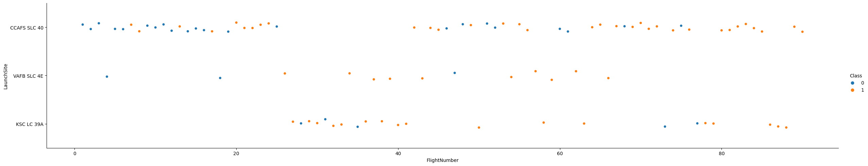
Flight Number vs. Launch Site
We found that as flight number increased the successful launches increased as well. The launch site doesn’t seem to have big impact on the outcome.

Slide 19
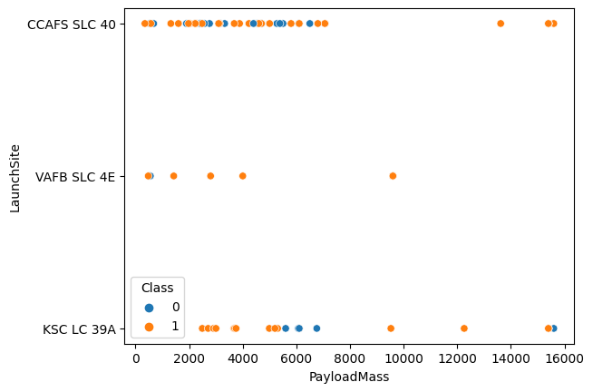
Payload vs. Launch Site
VAFB launch site doesn’t have any payloads larger than 10000kg.

Slide 20
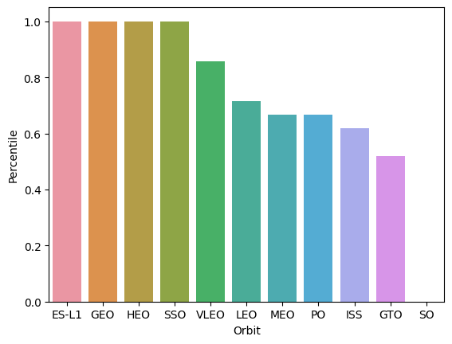
Success Rate vs. Orbit Type
We have 4 orbits with 100 success rate, some of them only have 1 launch. It seems GTO and SO are the most at risk orbits.

Slide 21
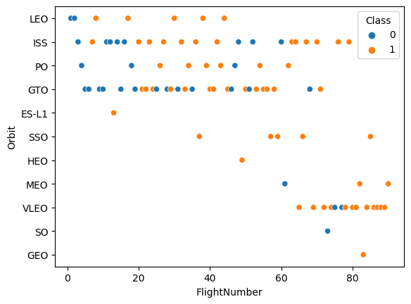
Flight Number vs. Orbit Type
With increased flight number we see increased success. When a new orbit is introduced, there is a higher chance of failure.

Slide 22
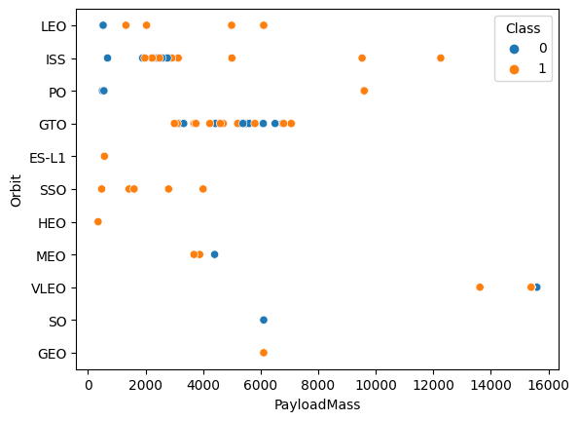
Payload vs. Orbit Type

Slide 23
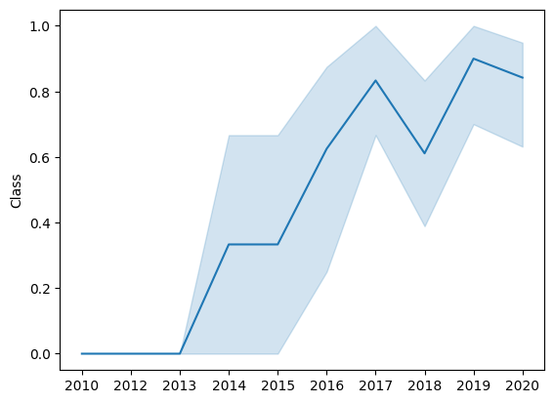
Launch Success Yearly Trend
We see an increase in success starting from 2013 until 2017. Then a small decline and increase again.

Slide 24
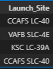
All Launch Site Names
%sql select distinct Launch_Site from spacextable
The query searches for distinct launch sites in the table.

Slide 25
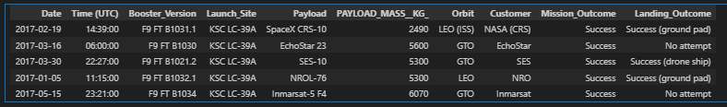
Launch Site Names Begin with 'KSC'
%sql select * from spacextable where Launch_Site like 'KSC%' limit 5
Use like to search for similar strings and Limit to limit the number of rows.

Slide 26
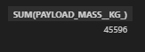
Total Payload Mass
%sql select SUM(PAYLOAD_MASS__KG_) from spacextable group by Customer having Customer = 'NASA (CRS)’
Group by customer and sum the payload mass.

Slide 27
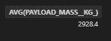
Average Payload Mass by F9 v1.1
%sql select AVG(PAYLOAD_MASS__KG_) from spacextable group by Booster_version having Booster_version = 'F9 v1.1’
Group by booster version and filter the groups for F9 v1.1

Slide 28

First Successful Ground Landing Date
%sql select min(date) from spacextable where Mission_outcome = 'Success’
Simple where query with min() for the date.

Slide 29
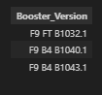
Successful Drone Ship Landing with Payload between 4000 and 6000
%sql select booster_version from spacextable where landing_outcome = 'Success (ground pad)' and (PAYLOAD_MASS__KG_ between 4000 and 6000)
Use where with and for 2 conditions and between to find the numerical value.

Slide 30
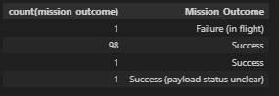
Total Number of Successful and Failure Mission Outcomes
%sql select count(mission_outcome), mission_outcome from spacextable group by mission_outcome
Group by mission outcomes and count them.

Slide 31
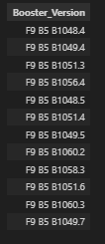
Boosters Carried Maximum Payload
%sql select distinct booster_version from spacextable where PAYLOAD_MASS__KG_ = (select max(PAYLOAD_MASS__KG_) from spacextable)
Use a sub query to find the boosters that carry the max payload.

Slide 32
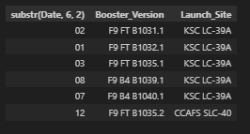
2015 Launch Records
%sql select substr(Date, 6, 2), booster_version, launch_site from spacextable where landing_outcome = 'Success (ground pad)' and substr(Date,1,4)='2017'

Slide 33
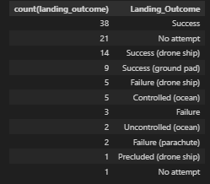
Rank Landing Outcomes Between 2010-06-04 and 2017-03-20
%sql select count(landing_outcome), landing_outcome from spacextable group by landing_outcome order by 1 desc

Slide 34

Section 3

Slide 35
<Folium Map Screenshot 1>
Replace <Folium map screenshot 1> title with an appropriate title
Explore the generated folium map and make a proper screenshot to include all launch sites’ location markers on a global map
Explain the important elements and findings on the screenshot

Slide 36
<Folium Map Screenshot 2>
Replace <Folium map screenshot 2> title with an appropriate title
Explore the folium map and make a proper screenshot to show the color-labeled launch outcomes on the map
Explain the important elements and findings on the screenshot

Slide 37
<Folium Map Screenshot 3>
Replace <Folium map screenshot 3> title with an appropriate title
Explore the generated folium map and show the screenshot of a selected launch site to its proximities such as railway, highway, coastline, with distance calculated and displayed
Explain the important elements and findings on the screenshot

Slide 38

Section 4

Slide 39
<Dashboard Screenshot 1>
Replace <Dashboard screenshot 1> title with an appropriate title
Show the screenshot of launch success count for all sites, in a piechart
Explain the important elements and findings on the screenshot

Slide 40
<Dashboard Screenshot 2>
Replace <Dashboard screenshot 2> title with an appropriate title
Show the screenshot of the piechart for the launch site with highest launch success ratio
Explain the important elements and findings on the screenshot

Slide 41
<Dashboard Screenshot 3>
Replace <Dashboard screenshot 3> title with an appropriate title
Show screenshots of Payload vs. Launch Outcome scatter plot for all sites, with different payload selected in the range slider
Explain the important elements and findings on the screenshot, such as which payload range or booster version have the largest success rate, etc.

Slide 42

Section 5

Slide 43
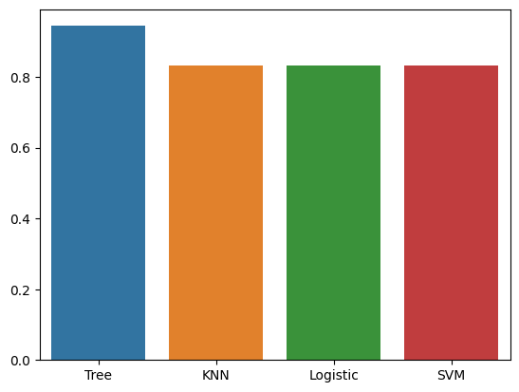
Classification Accuracy
Highest accuracy is the Tree model, coming in with 94%. The rest are all 83%..

Slide 44

Confusion Matrix
It classified 5 true positives correctly, meanwhile it predicted 1 false positive.
It didn’t predict any false negatives, and it got all true negatives correctly.

Slide 45
Conclusions
It’s been a real journey.
We learned a lot.
But the real learning experience is the friends we made a long the way.
Family

Slide 46
Appendix
Include any relevant assets like Python code snippets, SQL queries, charts, Notebook outputs, or data sets that you may have created during this project

Slide 47


